Slide 1

Monitoring & Life Support Equipment
By Maria Cecilia ZS Rebaño, PT
August 17, 2016

Slide 2
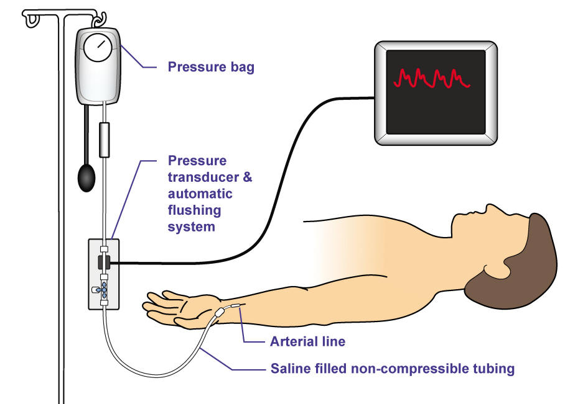
Monitoring Equipment
Primarily address concerns involving cardiovascular, pulmonary, and neurological systems
Device to detect physiological event of interest
Amplifier to increase magnitude signal from sensor
Recorder or meter to display the resultant signal

Slide 3
Hemodynamics (Hæmodynamics)
Fluid dynamics of blood flow
The goal of hemodynamic monitoring is to maintain adequate tissue perfusion.
Classical hemodynamic monitoring is based on the invasive measurement of systemic, pulmonary arterial and venous pressures, and of cardiac output.
Ex: Since organ blood flow cannot be directly measured in clinical practice, arterial blood pressure is used, as estimate of adequacy of tissue perfusion.

Slide 4
It is important for therapists to be capable of recognizing medical emergencies that require immediate treatment.
Knowledge about recognizing reasons for the presence of equipment, interpreting the settings and readouts, and the ability to assimilate the information with the correlating clinical picture is essential for providing safe interventions in the critical care setting.
Therapists must be capable of identifying the cause of an alarm and taking appropriate measures to correct the problem before silencing it during a treatment.

Slide 5

Lines Management 101
Just to start us off.

Slide 6
Pre-Treatment
Review the chart for lines, drains, equipment, devices
Learn specific parameters & precautions that protect the Pt, therapist, or both
Discuss planned interventions with RN
Treatment Protocols
Observe + Inventory: Pt's position, appearance
Systematically verify presence of documented lines (left to right, top to bottom, survey environment - everything is to be considered in the plan for mobilization)
Note all the readings on monitors, before, during, after tx
Anticipate how interventions will affect VS, how they will look on the monitor, and what can artificially change based on position change response

Slide 7
Treatment Protocols
Discuss with RN any lines that can be temporarily disconnected
Gently trace (tactile) each line from Pt to source
Always ask for assistance to untangle or free any lines that may be under the Pt
Ensure there is no tension on any line prior to moving the Pt.
DO NOT attempt to free a line you cannot completely visualize! Always ask for assistance in mobilizing Pts

Slide 8
Noninvasive vs Invasive
Electrocardiogram
Pulse Oximetry (Sp02)
Blood Pressure Monitoring (NIBP) - sphygmomanometry
Respiratory Rate
Level of Consciousness (Bispectral Index Sensor)
End Tidal CO2 (etCO2 or ETCO2)
Arterial Line
Central Line
PAC (Pulmonary Artery Catheter / Swan-Ganz Catheter)
Chest Tube(s)
Temperature monitoring
ICP (Intracranial Pressure monitoring)

Slide 9
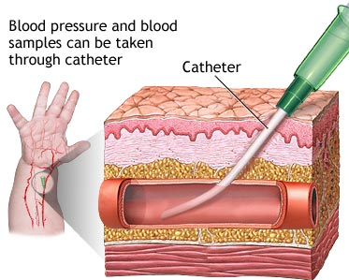
Arterial Line
"art-line" or "a-line"
thin catheter inserted into an artery to monitor blood pressure directly, in "real-time"
obtain arterial blood gas (ABG)
most common: radial, femoral
less common: brachial, axillary, ulnar, dorsalis pedis

Slide 10
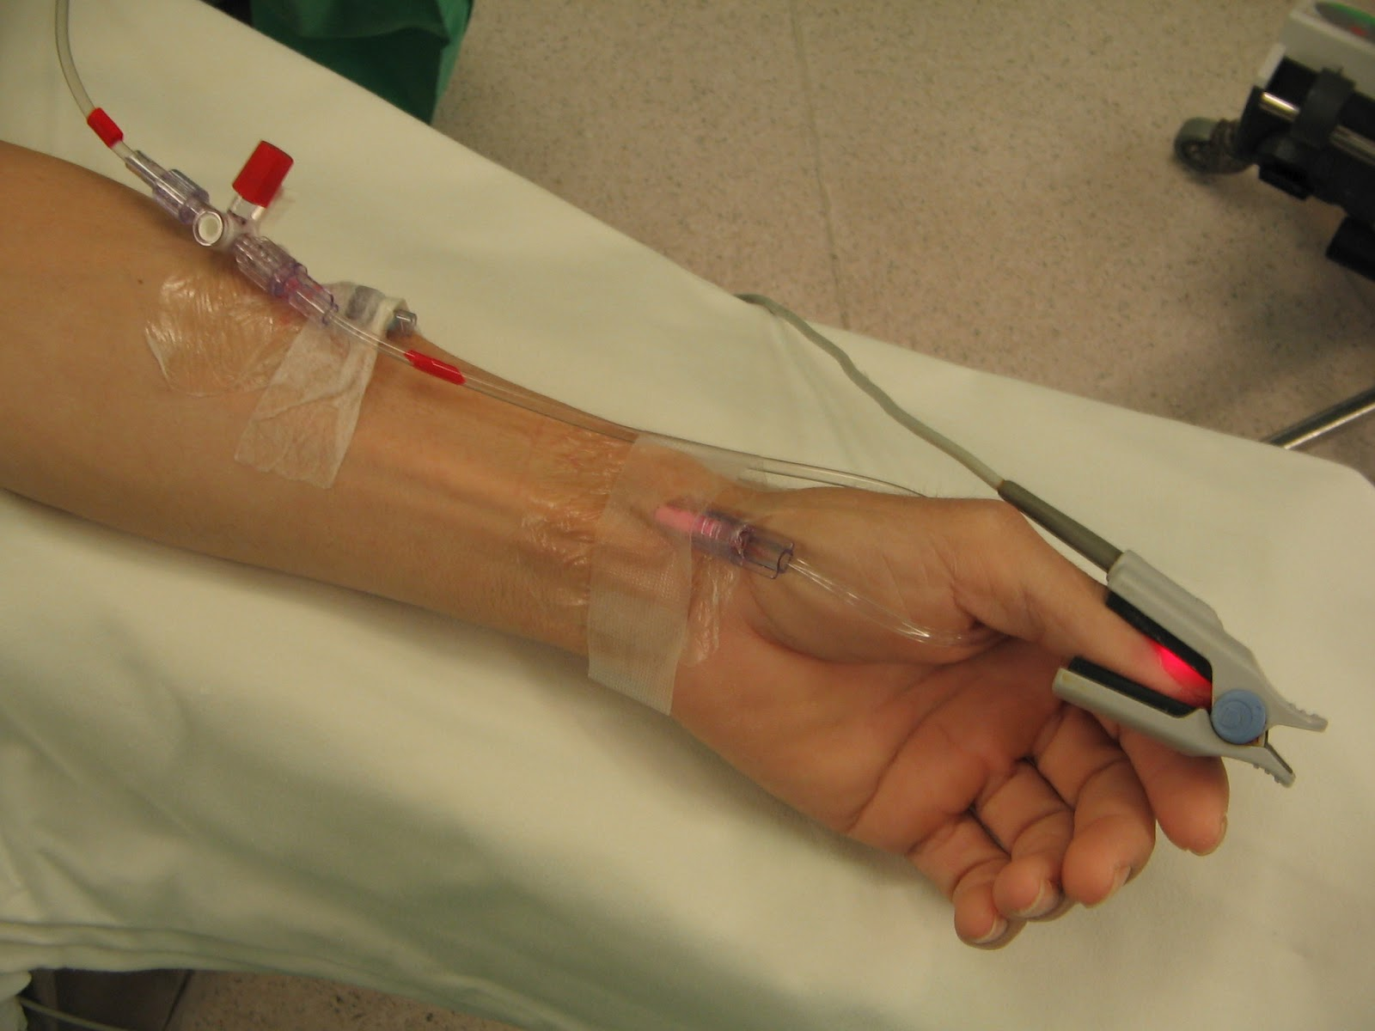
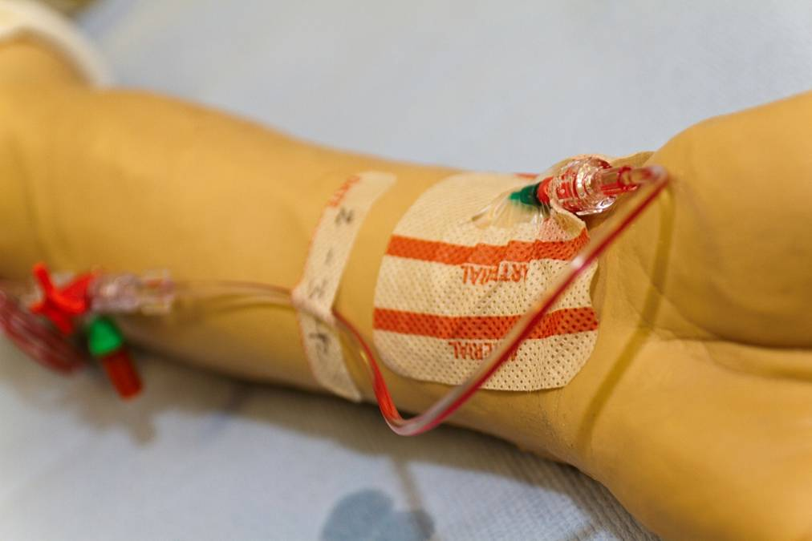
Arterial Line
Pt on inotropic drugs
Pt on vasoactive drugs
Pt requires frequent arterial blood gas sampling, provides ease of access, reduce "sticks"
continuous monitoring (SBP, DBP, MAP)

Slide 11

Which Pressure?
Which pressure should be monitored depends on the clinical situation.
systolic pressure is important when there is a high risk of bleeding
diastolic pressure is important in determining coronary perfusion pressure and therefore is particularly important in patients with coronary disease
mean arterial pressure is a major determinant of perfusion pressure of other organs

Slide 12
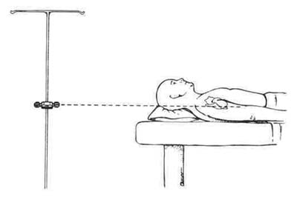
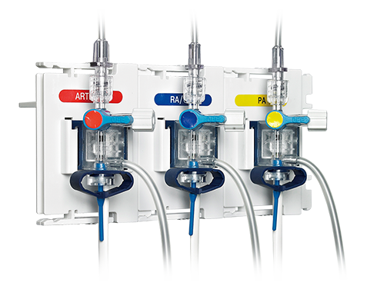
Arterial Line
4th ICS midway A-P
Transducer at level of RA
Too low = Higher BP (over reading)
Too high = Lower BP (under reading)
IF an arterial line is dislodged accidentally, apply pressure immediately (up to 5 mins) and notify nursing staff.

Slide 13
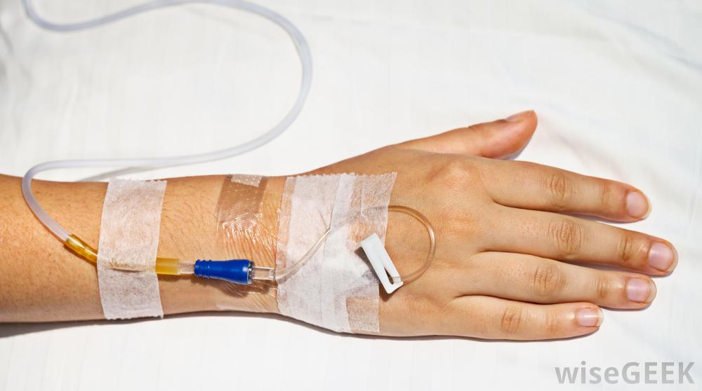
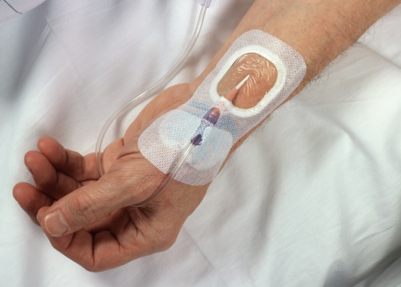

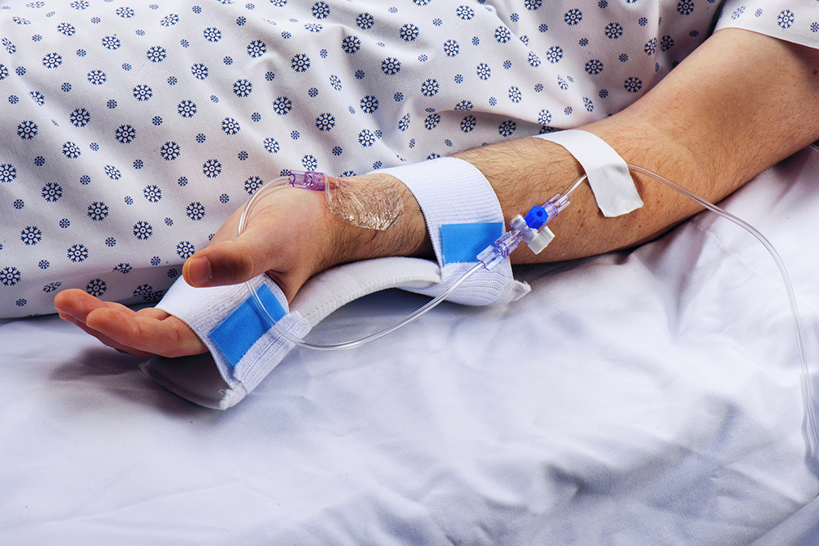

Arterial Line
MAP: Mean Arterial Pressure
Tissue Perfusion Pressure
The same in all parts of the CV system when supine
Does not vary significantly with motion artifact
70-110 <60
DBP + DBP + SBP
3
i.e. 110/70 (83)
armboard

Slide 14
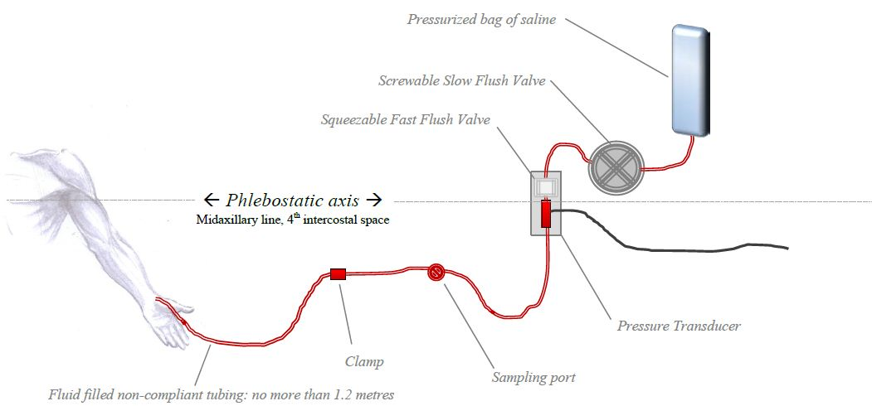
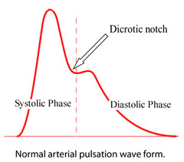
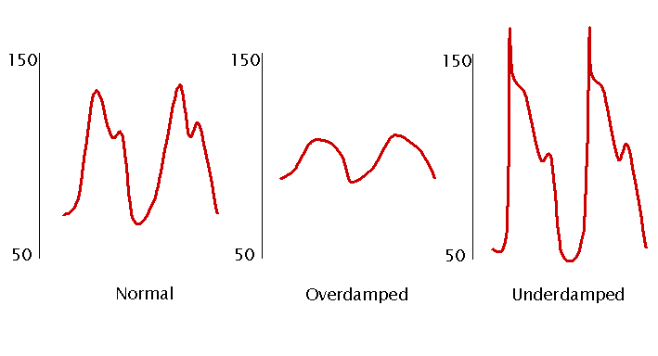
Arterial Line
Waveform
Waveform quality must be assessed prior to acceptance of a displayed pressure value. Pressures are derived from the detected waveform; poor quality waveforms will produce inaccurate pressure readings.
Abnormal Readings
Waveform changes may occur during alteration of intrathoracic or intrapericardial pressures. They may indicate presence of cardiac tamponade, pericarditis, aortic insufficiency.
Look at MAP

Slide 15
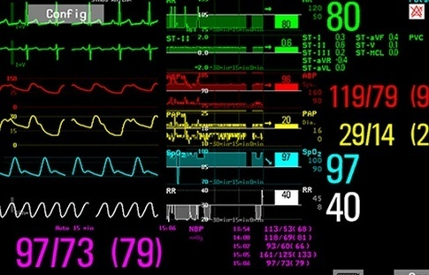
Arterial Line
2)

Slide 16
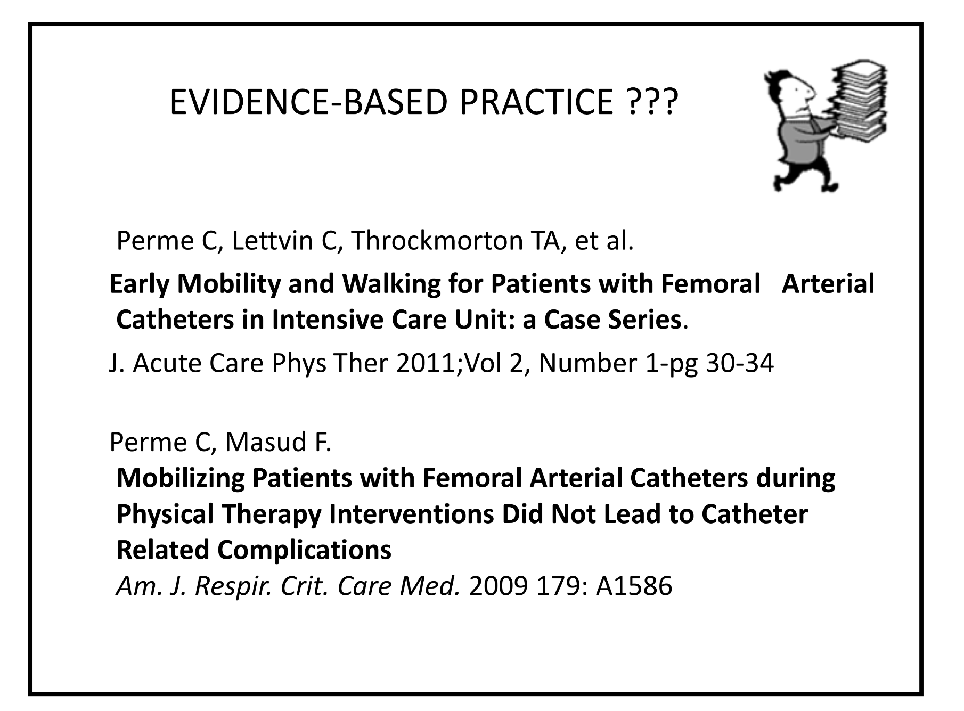
Mobilizing with Arterial Lines
If not on high dose pressors, ok to mobilize
Femoral line - dangling ok, standing possible if asymptomatic and all other vitals signs stable
Generally NO Ambulation

Slide 17

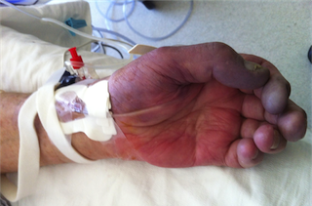
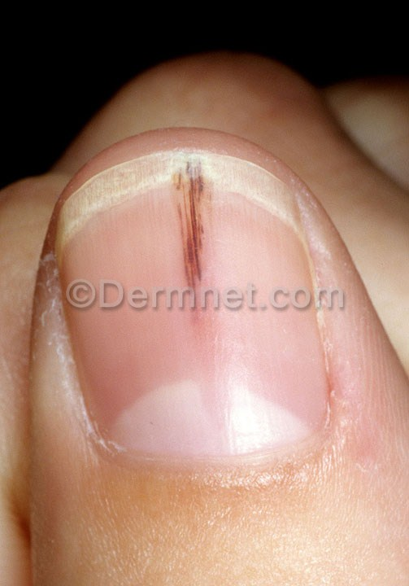
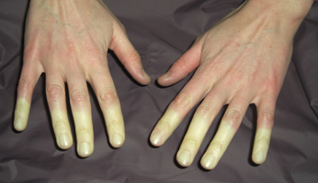
Complications
Hemorrhage - from disconnection, or around the line
Distal Ischemia - color and sensation changes, loss of function
Arterial thrombosis or embolism (may manifest as "splinter hemorrhages")
Accidental drug injection
Damage to artery, e.g. Aneurysm, retrograde air embolism
Look for signs and symptoms of pain, pallor, cyanosis, diaphoresis, significant changes in vital signs

Slide 18
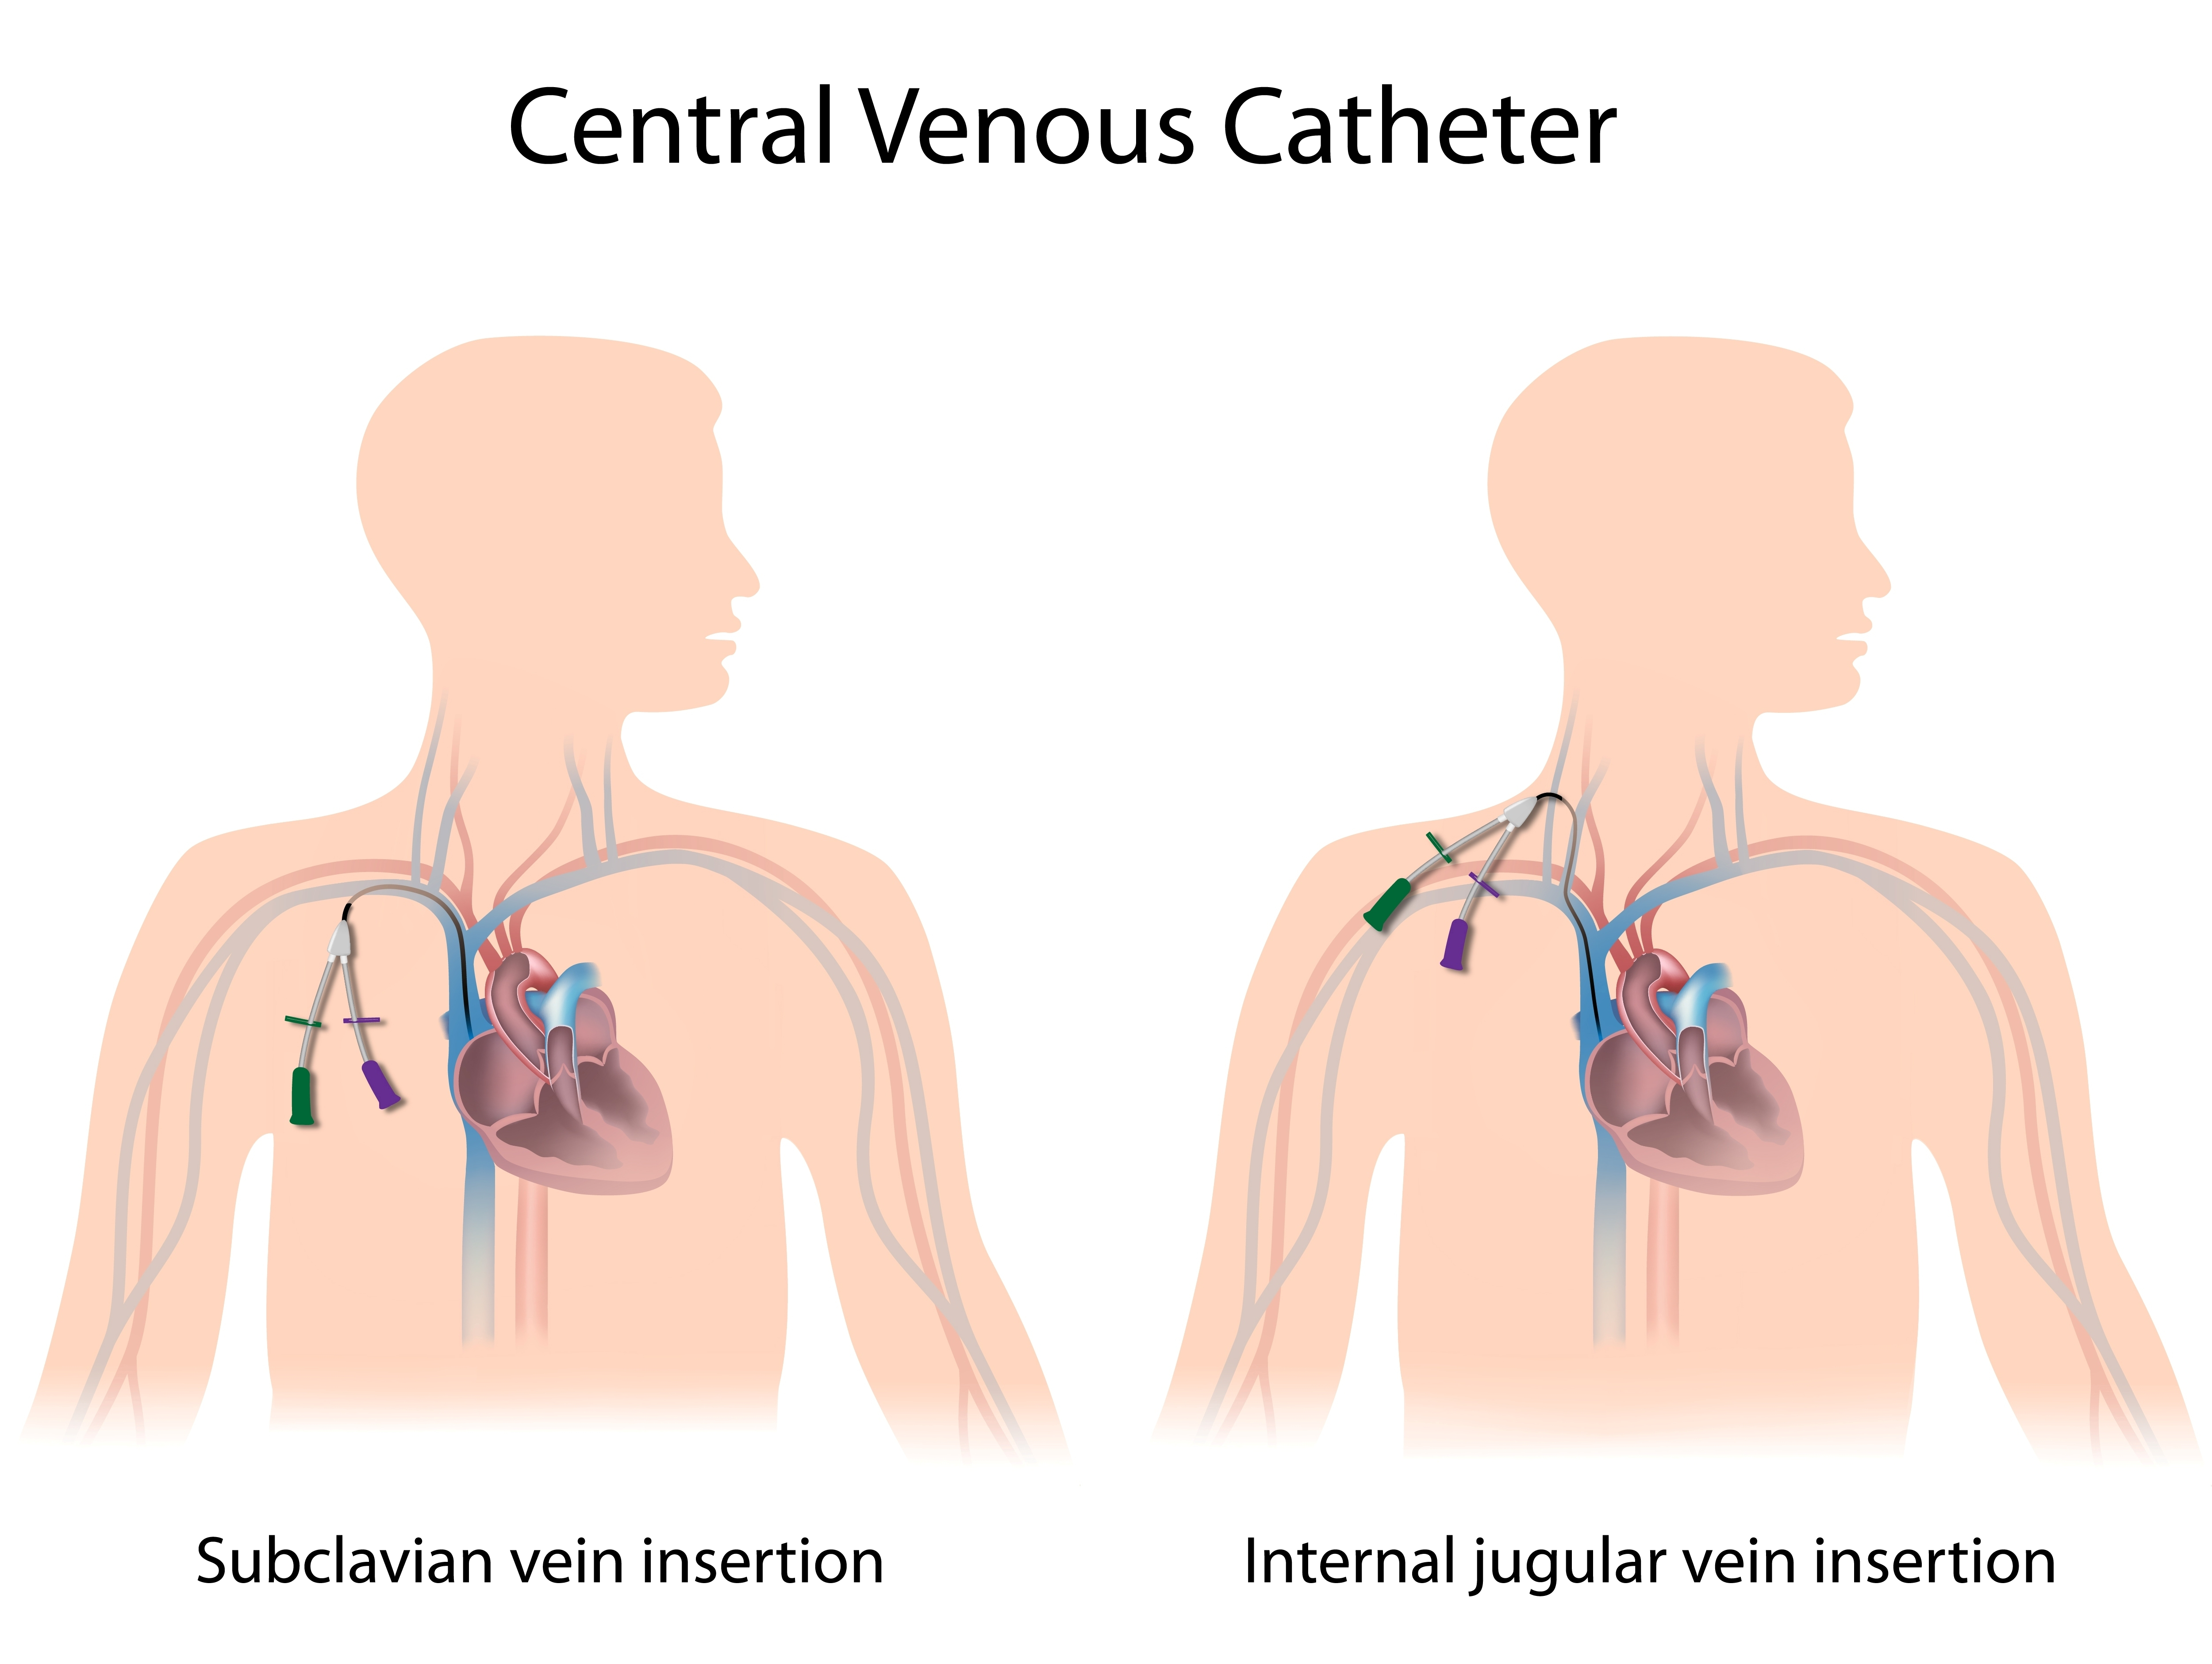
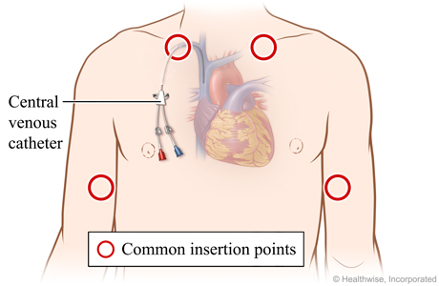
Central Line
"central venous catheter", "central venous line", "central venous access catheter"
placed by a physician, under US guidance, with follow-up CXR to confirm placement & ensure no pneumothorax was caused
most common: int. jugular (neck), subclavian or axillary (chest), rests in proximal SVC
less common: femoral v. (groin), or through arms (PICC)

Slide 19
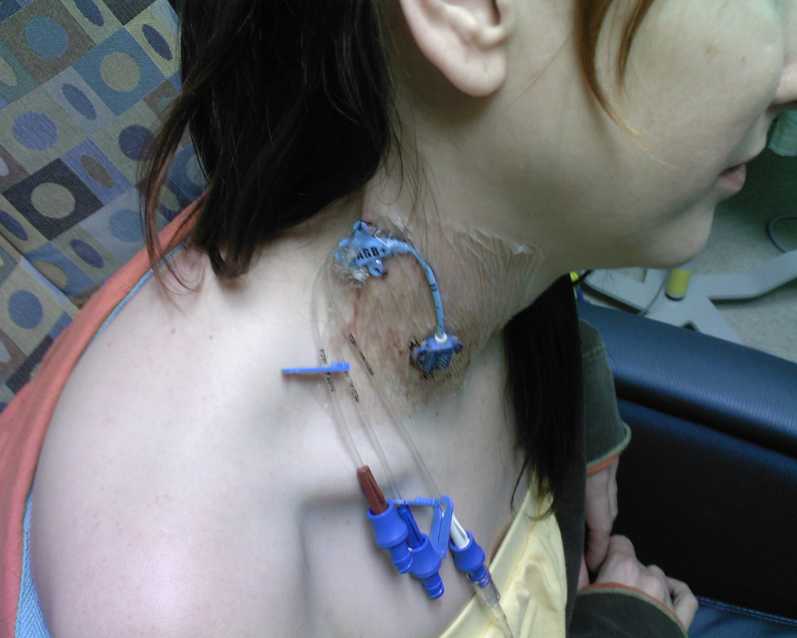
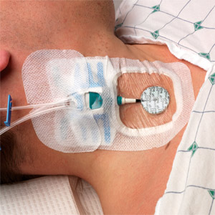
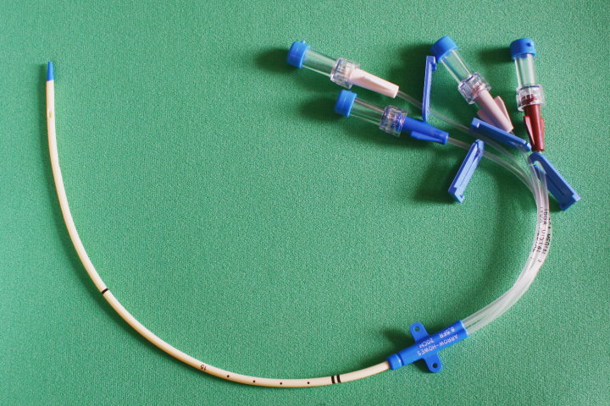
Central Line
allows IV access for meds & other procedures, blood sampling
route for emergency placement of a temporary pacemaker
use for Total Parenteral Nutrition
continuous monitoring of central venous pressure (CVP) or right atrial pressure (RAP)

Slide 20
Central Line
administer blood products, plasmapheresis
dialysis, central temp monitoring
frequent blood draws, medications
rehydration/fluid admin (central venous 02 sats)
measures ScvO2 (mixed venous oxygen saturation) reflects the amount of oxygen "left over" after the tissues remove what they need
Some caustic agents which may make peripheral veins prone to phlebitis include:
Calcium chloride
Chemotherapy
Hypertonic saline
Potassium chloride (KCl)
Amiodarone
Vasopressors (epi, norepi)

Slide 21
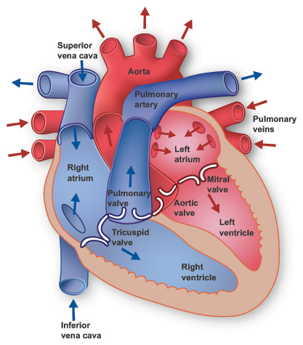
Anatomy of the Heart

Slide 22
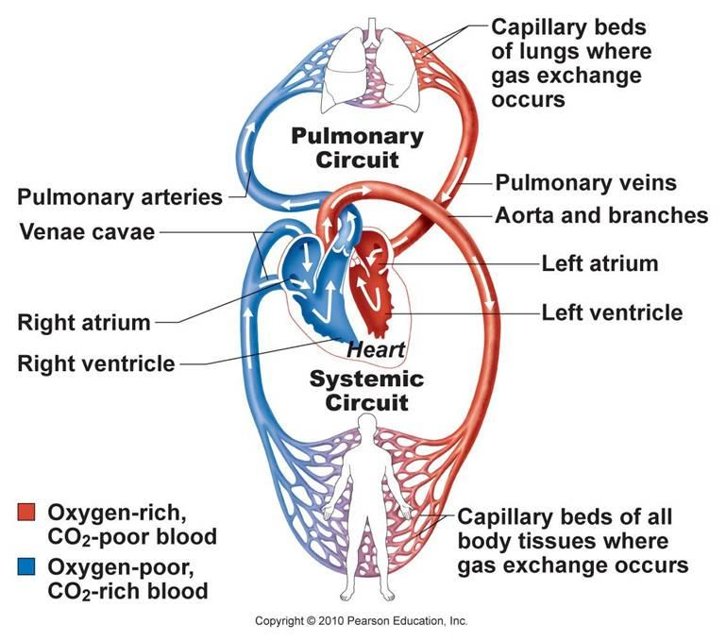
Pulmonary & Systemic Circulation

Slide 23


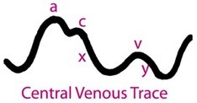
Central Line
CVP reflects the amount of blood returning to the heart and the ability of the heart to pump the blood back into the arterial system.
Measures ScvO2 (mixed venous oxygen saturation) reflects the amount of oxygen "left over" after the tissues remove what they need
Central Venous Pressure (CVP) - pressure in vena cava, approx. of R. Atrial Pressure (RAP)
CVP 3-8 | RAP 0-8
<hypovolemia, shock
>fluid overload, high PEEP, RV failure, pericardial effusion, tricuspid insufficiency
CVP WAVEFORM
a = atrial contraction
c = closing and bulging of the tricuspid valve
x = atrial relaxation
v = passive filling of atrium
y = opening of the tricuspid valve

Slide 24
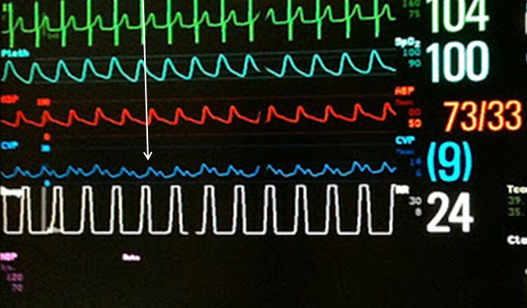
Central (Venous) Line

Slide 25
Mobilizing with Central Lines
If not on high dose pressors, ok to mobilize
Femoral line - dangling ok, standing possible if Pt is asymptomatic and all other vitals signs stable
Follow protocols on hip angle and restrictions if available (70-80 degrees - not prolonged positioning)
Generally NO Ambulation

Slide 26
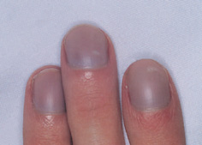
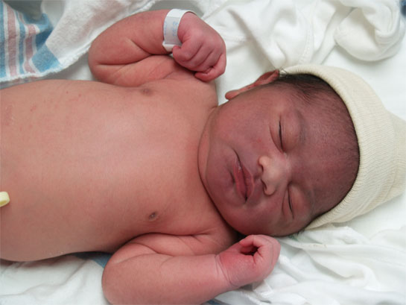
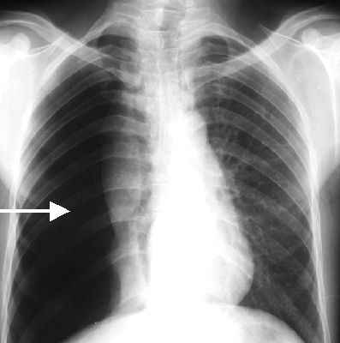

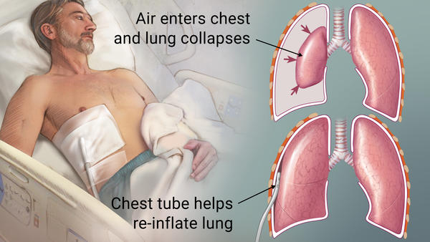
Complications
Infection, sepsis - fevers, chills, hypotension, tachycardia, confusion
Pneumo/Hemothorax - dyspnea, hypoxia, tachycardia, restlessness, cyanosis, chest pain, dec. lung sounds
Air Embolism - dyspnea, chest pain, tachycardia, hypotension, anxiety, nausea, dizziness, and confusion.
Arrhythmias, bleeding, hematomas

Slide 27
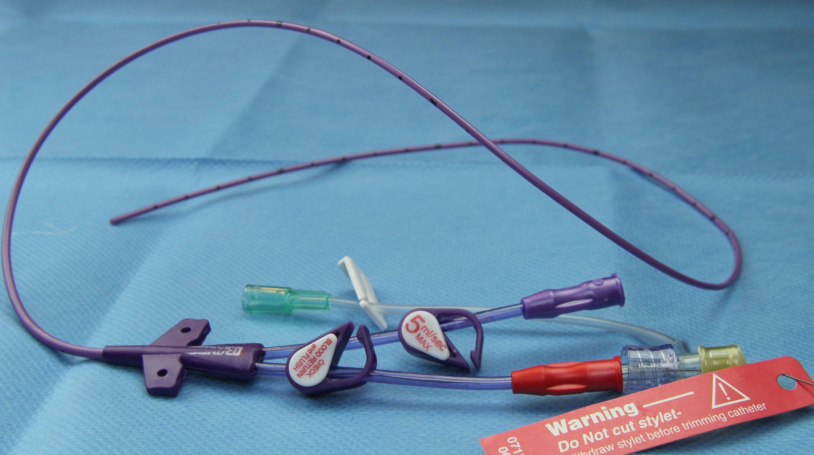
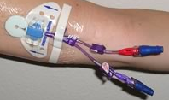
Central Line (alternatives)
For patients requiring a prolonged placement of a central line, to reduce risks of infections and occurrence of complications
PICC - Peripherally Inserted Central Catheter
also "percutaneous indwelling central catheter" inserted via US/fluoroscopy guidance
sites: cephalic, basilic, axillary v.
can use 6-12 mos
secured/sutured to prevent post-insertion movement
frequently flushed & "locked"

Slide 28
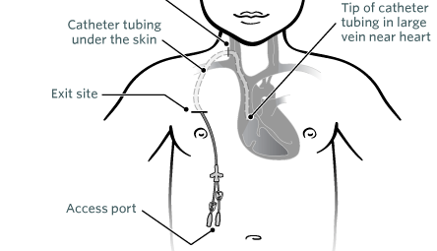
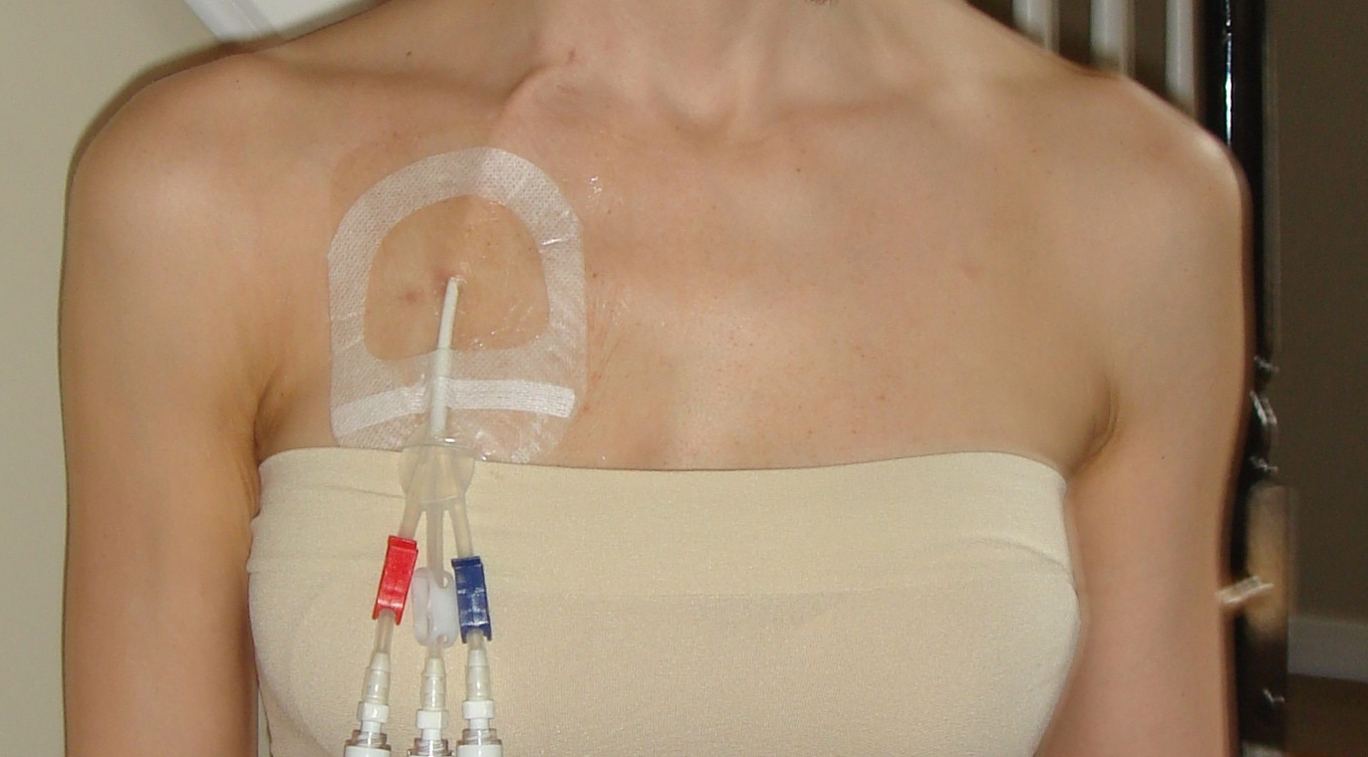
Central Line (alternatives)
For patients requiring a prolonged placement of a central line, to reduce risks of infections and occurrence of complications
Tunneled Catheters (Broviac, Hickman)
also "tunneled central line", it is tunneled under the skin, allows usage without a stick
placed surgically in OR
sites: common in neck (internal jugular), may also be in groin (femoral), liver (transhepatic), chest (subclavian) or back (translumbar).
cath has a (dacron) cuff to stabilize the device and prevent bacterial migration to bloodstream
2 surgical wounds: 1 near subclavian then exit wound in chest, exit site must be protected

Slide 29
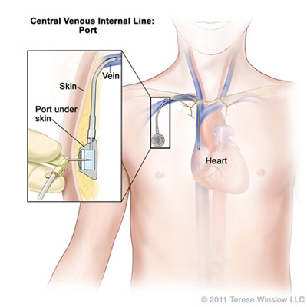
Central Line (alternatives)
For patients requiring a prolonged placement of a central line, to reduce risks of infections and occurrence of complications
Implanted or Subcutaneous Ports (mediport, port-a-cath, infusapor)
Surgically placed, are totally implanted into the subcutaneous tissue (tissue that is directly under the skin), most often on the chest.
A special “huber” (90 degree) needle is inserted through the skin and into the port by a medical professional before the port is used.
When it is “accessed,” a dressing is required, similar to an external catheter. When not being used, it is out of sight and needs no special care

Slide 30
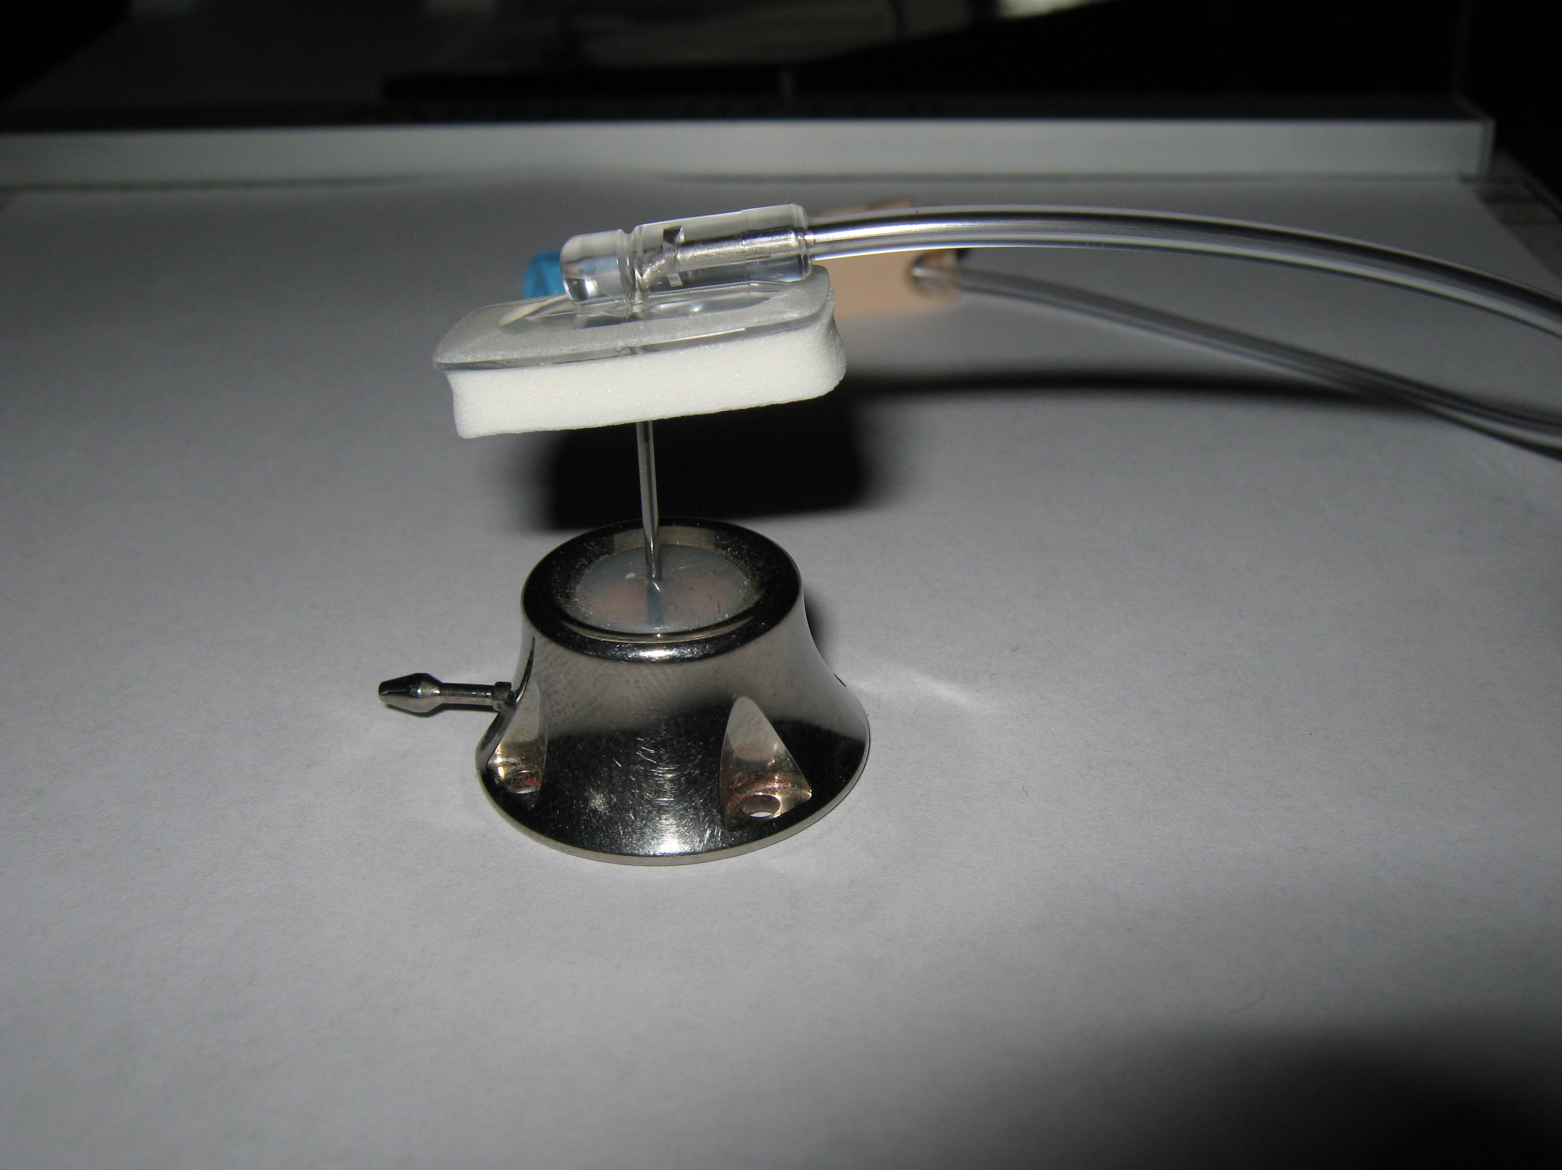
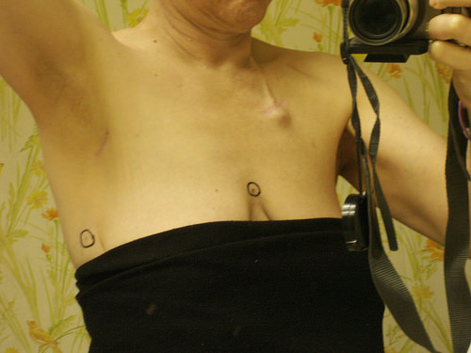
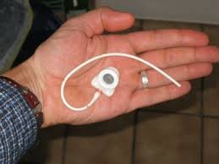
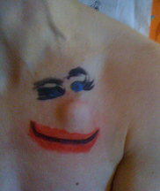


Slide 31
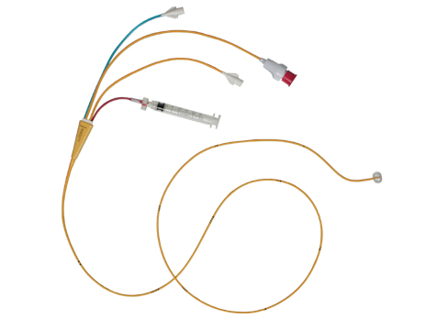
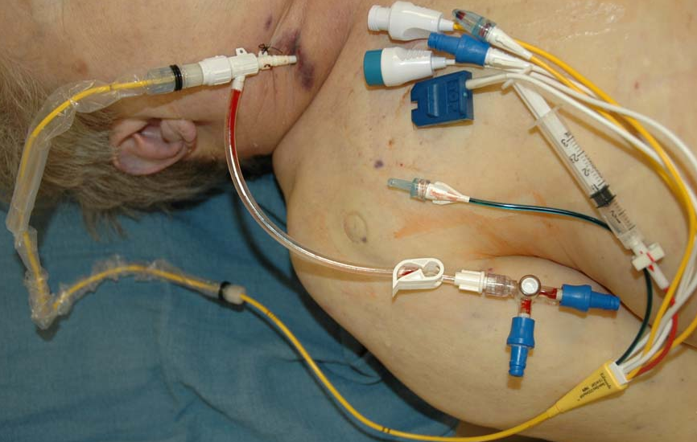
Pulmonary Artery Catheter
"Swan-Ganz", PAC, "yellow snake" (inf.)
directly measures RAP, PAP, PCWP; indirectly LAP
PAP 8-20 (mean) or 15-30/5-15 (Pas/Pad)
measures SvO2 and Cardiac Output
permits pacing of atria & ventricles
diagnostic; it is used to detect heart failure or sepsis, monitor therapy, and evaluate the effects of drugs (therapeutic)

Slide 32
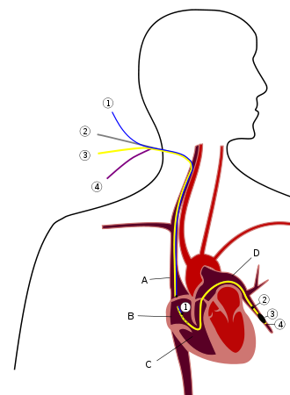
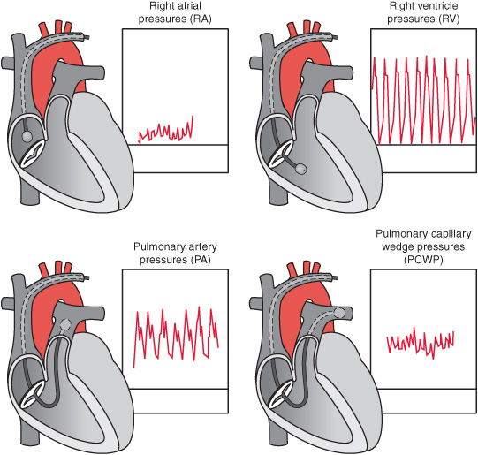
Pulmonary Artery Catheter

Slide 33
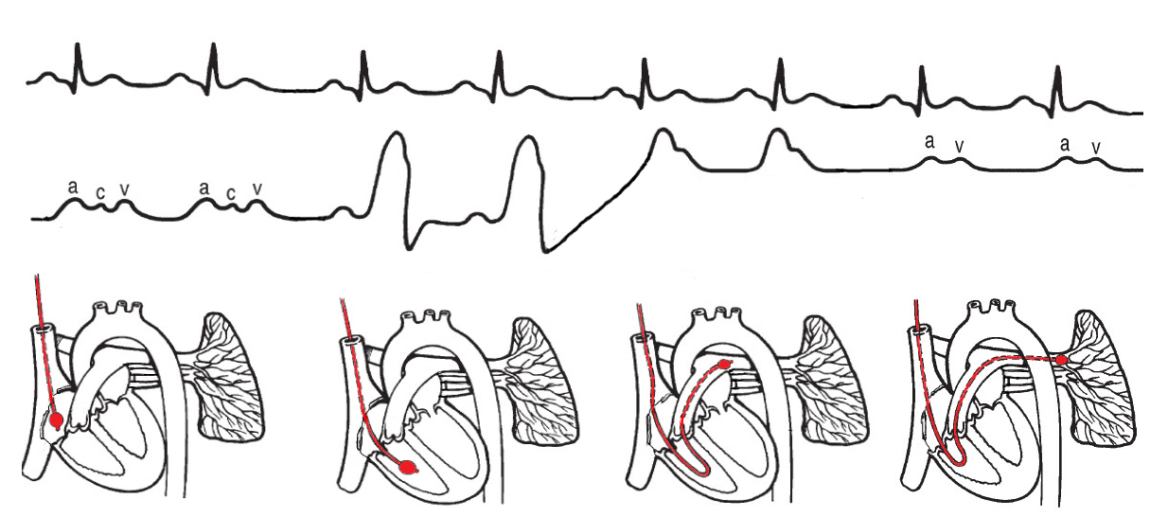
Pulmonary Artery Catheter
Pressure tracings of the right side of the heart
(waveforms)
PCW
RA
RV
PA
right atrium right ventricle pulmonary artery capillary wedge

Slide 34

Pulmonary Artery Catheter
Pt potentially hemodynamically unstable (often on bed rest)
Pt needs continuous invasive monitoring i.e. 1-2 wks (ok seated Thera-ex, bed to chair, rarely closely supervised on stationary bike)
right ventricular failure
pulmonary hypertension
weaning failure of cardiac origin
post-cardiac surgery
pending heart transplants

Slide 35
Pulmonary Artery Catheter
0)

Slide 36
Mobilizing with PAC
When this line is present, mobilization, if necessary, must be undertaken by an experienced clinician after it has been determined that Pt is hemodynamically stable.
PA line must be locked to prevent catheter tip from advancing
Avoid ROM & therapeutic exercise to the ipsilateral shoulder. Movement of the PA line may cause arrhythmias, intravascular ulnar injury, or the line becomes dislodged
Monitor the waveforms & Pt clinical response/appearance

Slide 37
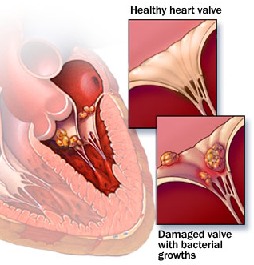
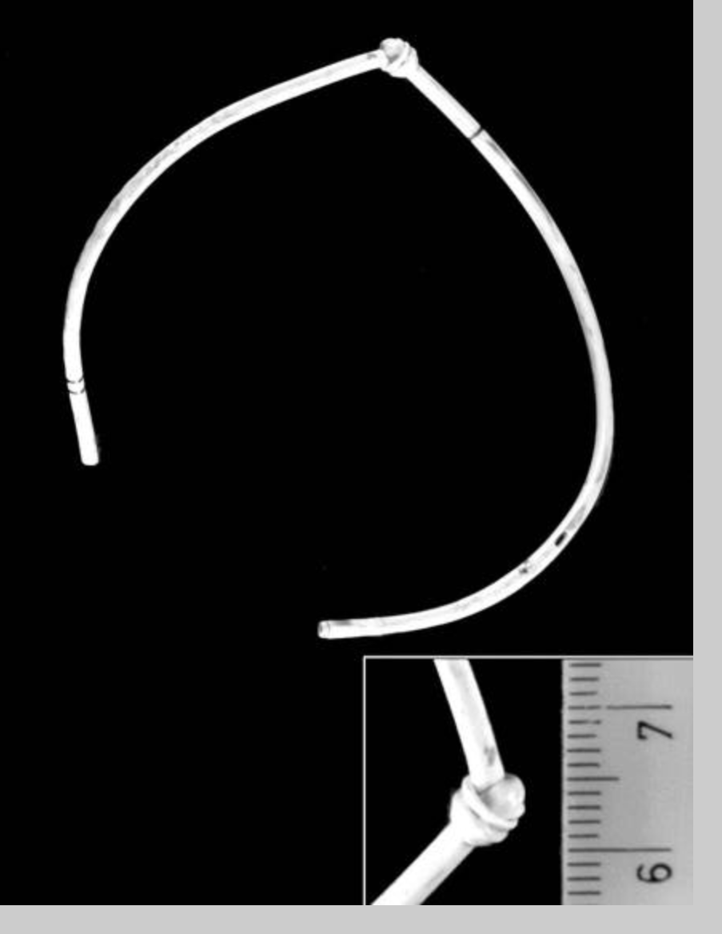
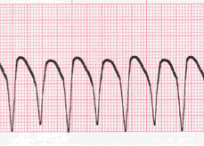
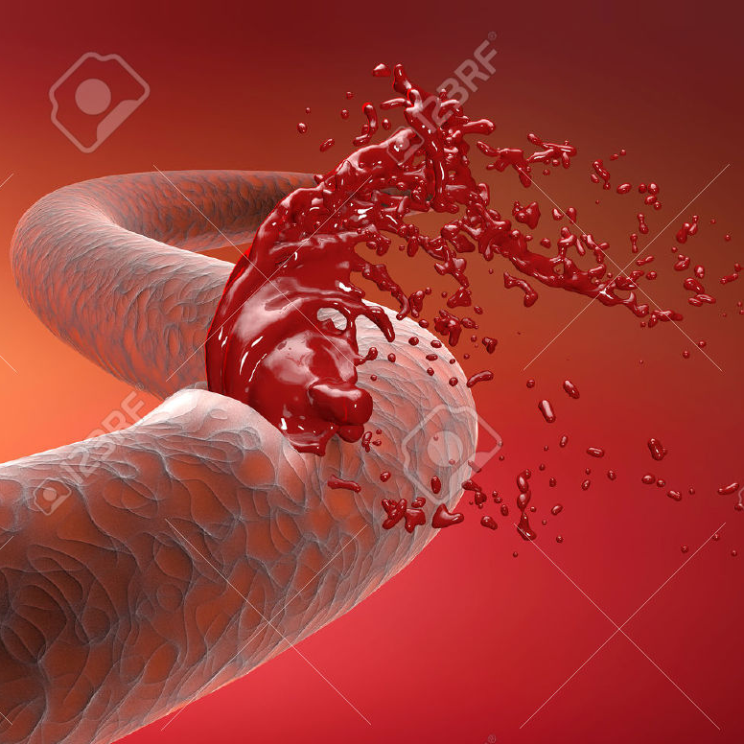
Complications
Vessel rupture - catheter tip advances into pulmonary artery
lethal arrhythmias if SA node stimulated, valve damage
Air embolism, hypotension, hypoxia, pulmonary infarction
(Late) Knotting, endocarditis

Slide 38
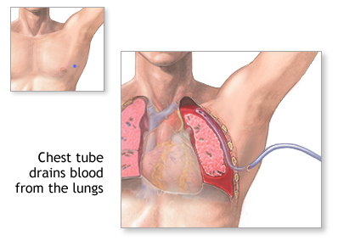
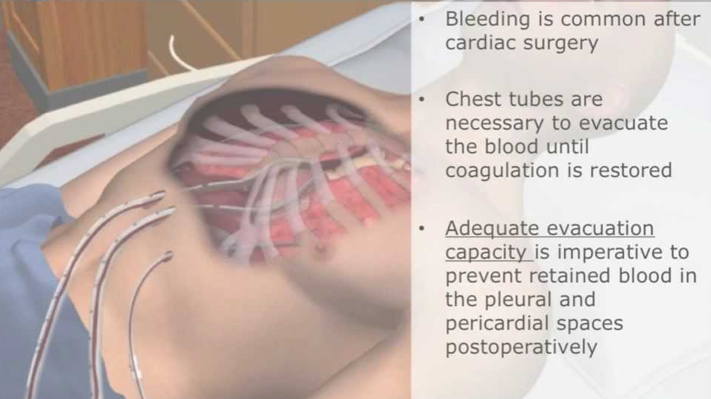
Chest Tubes
large catheters placed in the thoracic cavity
connected to a graduated collection reservoir at bedside
used to prevent reentry or remove air or fluid from pleural or mediastinal space, and provide negative intrapleural pressure

Slide 39

Chest Tubes
Pneumothorax : Open or closed; simple or tension
Hemothorax
Hemopneumothorax
Hydrothorax
Chylothorax
Empyema
Pleural effusion
Patients with penetrating chest wall injury who are intubated or about to be intubated.

Slide 40

Chest Tubes
Cardiac
After thoracic surgery, chest tubes placed in mediastinum to drain the pericardium
Expect 50-200 ml after surgery, and about 500 ml over the first 24 hours. Report anything that exceeds 70 ml/hr after that
When mobilizing, ensure that the Pt is premedicated for pain. Don't be afraid to move the patient unless otherwise ordered, as position changes are essential to facilitate drainage, help avoid complications, and help make Pt more comfortable

Slide 41


Chest Tubes
Pleural
In non-surgical situations, commonly inserted in 6th ICS in mid, or posterior axillary line
Apical chest tubes generally drain air
Expect 100-300 ml during first 3 hrs after pleural insertion. It declines after 2 hrs, amounting to 500-1000 ml in first 24 hrs
Crackling or "rice crispies" palpation near dressing or insertion site is a sign of subcutaneous emphysema. This is air that gets trapped beneath the skin. A possible cause of this is a poor seal at the chest-tube insertion site.

Slide 42


Chest Tubes

Slide 43
Mobilizing with Chest Tubes
Ensure Pt is premedicated for pain
Always keep chest tube drainage system below the chest level/incision, and ensure it is upright at all times, don't let it tip!
Check for air leaks (air bubbles will be present in the underwater seal)
Always discuss with MD or RN prior to disconnecting suction (i.e., wall vs water seal, clamping)
After CT removed, HOLD therapy until radiograph rules out PTX.

Slide 44
Complications
Infection, sepsis - fevers, chills, hypotension, tachycardia, confusion
Pneumo/Hemothorax - dyspnea, hypoxia, tachycardia, restlessness, cyanosis, chest pain, dec. lung sounds, abrupt drop in Sp02 from BL/< 80%
Poor Tube placement - too far in, damaging other organs (lung, diaphragm, stomach), or too far out that it falls off
Arrhythmias, bleeding, hematomas
Indications of Respiratory Distress
Increased RR
Nasal flaring
Intercostal & sternal retractions
Visible expression of distress
Increased use of neck accessories
Paradoxic breathing

Slide 45


Nasogastric Tube
"NGT"
Diagnostic:
Evaluate upper GIB
Aspirate gastric contents (or toxic subs)
Administer radiographic contrast
Therapeutic:
Gastric decompression (suctions)
Feeding, administer medications
Bowel irrigation

Slide 46



Nasogastric Tube
Take note of measurement at level of nostril

Slide 47
Common Hemodynamic Parameters
Parameter | Acronym | Normal Values | Clinical Significance
Arterial Blood Pressures | BP, NBP, ABP | (mmHg) | too high: art. damage/rupture, cause aneurysms, over stretch heart too low: cause fainting (lack of blood to brain), can signify shock or anaphylaxis
Systolic BP | SBP | 90-140
Diastolic BP | DBP | 60-80
Right Atrial Pressure | RAP/CVP | 0-8 | > can indicate tamponade, tension pneumothorax, pleural effusion, PE, forced exhalation < can indicate hypovolemia, distributive shock, deep inhalation
Right Vent Systolic Pressure | RVs | 15-30 | > caused by left sided heart failure (from Mitral or Aortic regurg, CHF), PE < usually due to cardiomyopathy from failure, dilation, ischemia (MI)
Pulmonary Artery Pressures | PAP | 8-20 (mean) | > SOB, fatigue, arrhythmias, weakness, dizziness (rest >25 or exs >30 = PAH) > Left ventricle failure, mitral valve pathology, cardiac insufficiency, cardiac compression
Pulm Art Wedge Pressure (LV function estimation) | PWP, PCWP | 4- 15 (mean)
Mean Arterial Pressure | MAP | 70-110 | > heart stressed, works harder, cause fatty deposits, lead to heart failure < lack of perfusion/blood flow causing shock, organ failure

Slide 48
Evidence-Based Practice
Mobilizing patients in ICU is safe, feasible and improves physical function, and continue improvement post-discharge. It can also reduce length of hospital stay and costs.
Bailey P . Crit Care Med. 2007 Jan;35(1):139‐45
Morris PE. Crit Care Med. 2008 Aug;36(8):2238‐43
Schweickert WD. Lancet. 2009 May ; 373:1874‐1882

Slide 49
Take-Away!
Do not
get a line dislodged!

Slide 50
References
admin (2016) Tube types - feeding tube awareness foundation. Available at: http://www.feedingtubeawareness.org/tube-feeding-basics/tubetypes/ (Accessed: 15 August 2016).
C, J.P., West, M.P. and Paz, J.C. (2013) Acute care handbook for physical therapists. 4th edn. United States: Elsevier Health Sciences.
CORONA, M.L., PETERS, S.G., NARR, B.J. and THOMPSON, R.L. (1990) “Infections related to central Venous catheters,” Mayo Clinic Proceedings, 65(7), pp. 979–986. doi: 10.1016/s0025-6196(12)65159-3.
Fernando, J. and LITFL (2012) Collections. Available at: http://lifeinthefastlane.com/ccc/pulmonary-artery-catheters/ (Accessed: 13 August 2016).
Hemodynamic monitoring study questions (no date) Available at: http://www.austincc.edu/adnlev4/rnsg2331online/lab/Hemodynamic%20Monitoring%20Study%20Questions.htm (Accessed: 15 August 2016).

Slide 51
References
Hillegass, E.A. (2011) Essentials of cardiopulmonary physical therapy. 3rd edn. Philadelphia, PA, United States: Elsevier Health Sciences.
Hodgin, K.E., Nordon-Craft, A., McFann, K.K., Mealer, M.L. and Moss, M. (no date) “Physical therapy utilization in intensive care units: Results from a national survey,” 37(2).
Jardins, T.D.R. (2007) Cardiopulmonary anatomy & physiology: Essentials for respiratory care. 5th edn. Nashville, TN, United States: Thomson Delmar Learning.
Lunardi, N., Bryant, M., Smith, K. and Lowson, S. (2012) “Early mobilization in critically ill patients,” ICU Director, 3(1), pp. 17–20. doi: 10.1177/1944451611435275.
Malone, D.J. and Lindsay, K.L.B. (2005) Physical therapy in acute care: A clinician’s guide. United States: Slack.

Slide 52
References
Merriweather, N. and Sulzbach-Hoke, L.M. (2012) “Managing risk of complications at Femoral vascular access sites in Percutaneous coronary intervention,” Critical Care Nurse, 32(5), pp. 16–29. doi: 10.4037/ccn2012123.
Munis, J.R. (2012) Just enough physiology. New York, NY, United States: Oxford University Press.
Perme, C., Lettvin, C., Throckmorton, T.A., Mitchell, K. and Masud, F. (2011) “Early mobility and walking for patients with Femoral arterial catheters in intensive care unit: A case series,” Journal of Acute Care Physical Therapy, 2(1), pp. 30–34. doi: 10.1097/01592394-201102010-00004.
Roy, S.H., Wolf, S. and Scalzitti, D. (2012) The rehabilitation specialist’s handbook. Philadelphia, PA, United States: F.A. Davis Company.
Wilcox, R. (2009) Standard of care: Cardiac inpatient physical therapy management of the surgical and non-surgical patient with cardiac disease. Available at: http://www.brighamandwomens.org/Patients_Visitors/pcs/rehabilitationservices/Physical-Therapy-Standards-of-Care-and-Protocols/Cardiac%20SOC.pdf

